Slide 1
Description of variable describing customers activities
Total Duration of the xDR in ms
Minimum value | 7.142988e+06
Maximum value | 1.859336e+09
average | 1.051299e+08
1st quartile | 5.837439e+07
2nd quartile | 8.639999e+07
3rd quartile | 1.329664e+08

Slide 2
Session Duration in ms
Minimum value | 7.142000e+03
Maximum value | 1.859336e+06
average | 1.051294e+05
1st quartile | 5.837400e+04
2nd quartile | 8.639900e+04
3rd quartile | 1.329658e+05

Slide 3
Total Download Data
Minimum value | 7.114041e+06
Maximum value | 9.029696e+08
average | 4.546996e+08
1st quartile | 2.431725e+08
2nd quartile | 4.560177e+08
3rd quartile | 6.657654e+08

Slide 4
Total Upload data
Minimum value | 2.866892e+06
Maximum value | 7.833131e+07
average | 4.112015e+07
1st quartile | 3.321763e+07
2nd quartile | 4.114375e+07
3rd quartile | 4.903338e+07

Slide 5
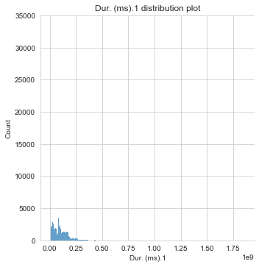
Distribution plots for variable in relation to whole dataset
Total duration of the xDR in ms
The duration distribution lies mostly between 0 and 1/8 of a millisecond with count less than 3000.

Slide 6
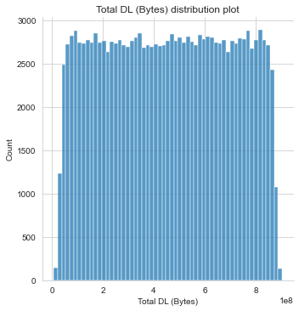
Total Download Volume distribution plot
The distribution rises quickly from 0 to 2500s, stays almost constant until it falls quickly at the end.

Slide 7
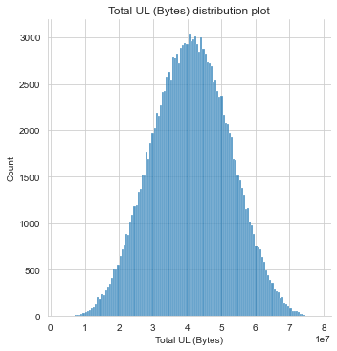
Total Upload Volume distribution plot
The distribution rises slowly until it reaches 3000 count with its upload bytes at the median and then descends slowly.

Slide 8
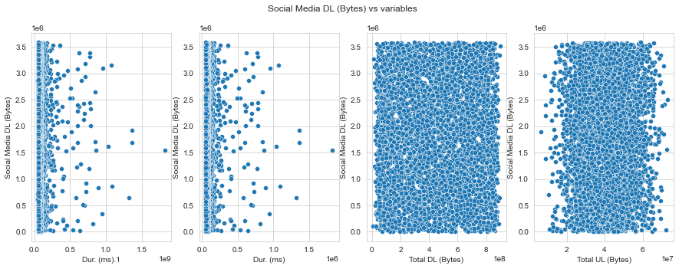
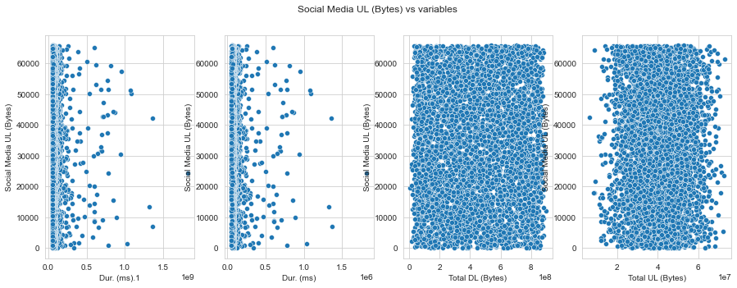
Graphical Univariate analysis for different applications vs the variables for a sample of 1000
Social Media Downloads
The duration for both is mostly concentrated between 0-0.5 ms
The total download is equally distributed
The total upload is somewhat distributed with more concentration in the middle

Slide 9
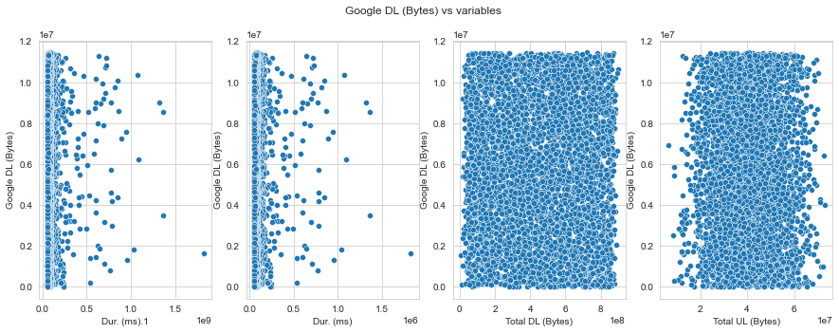
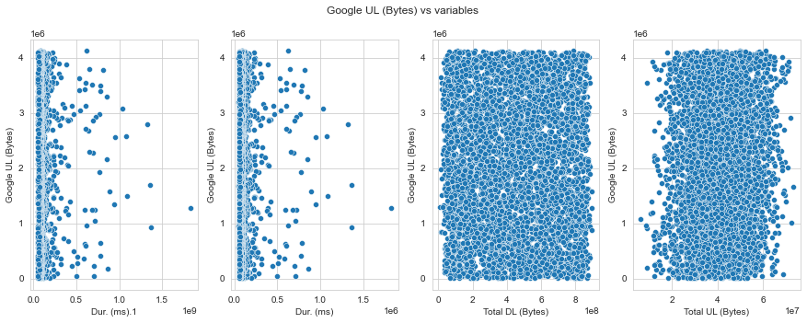
Google plots
The duration for both is mostly concentrated between 0-0.5 ms
The total download is equally distributed
The total upload is somewhat distributed with more concentration in the middle

Slide 10
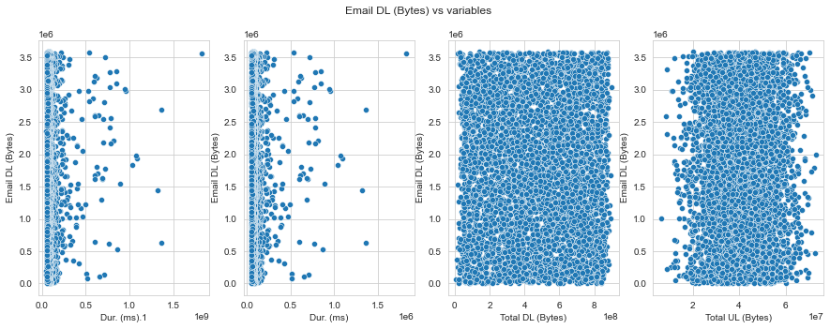
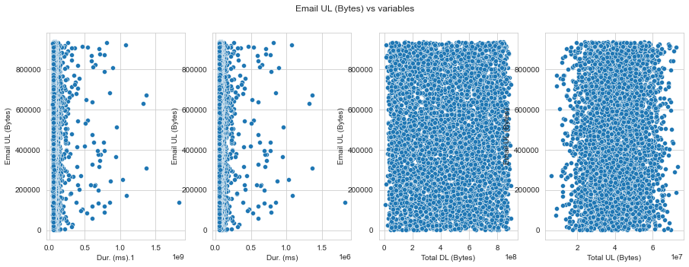
Email plots
The duration for both is mostly concentrated between 0-0.5 ms
The total download is equally distributed
The total upload is somewhat distributed with more concentration in the middle

Slide 11
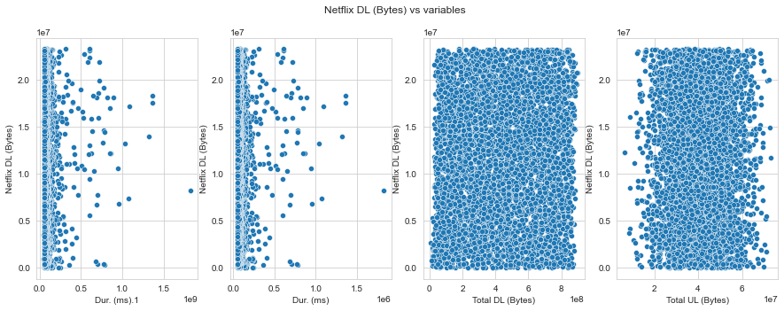
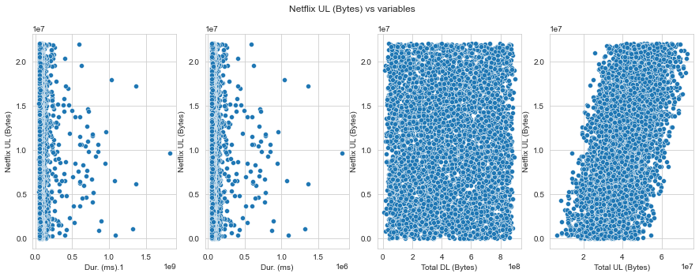
Netflix plots
The duration for both is mostly concentrated between 0-0.5 ms
The total download is equally distributed
The total upload is somewhat distributed with more concentration in the middle

Slide 12
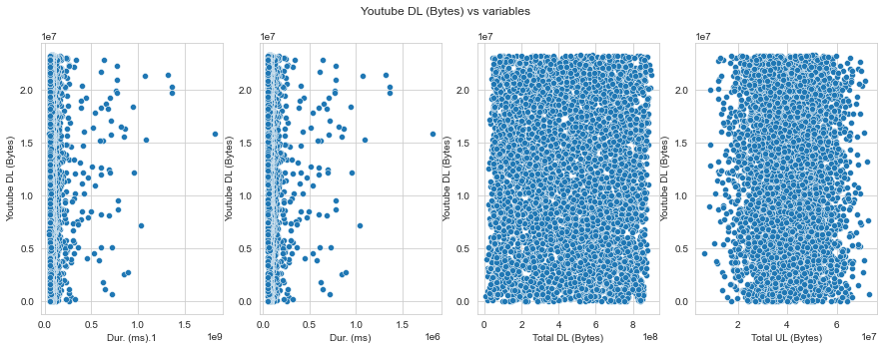
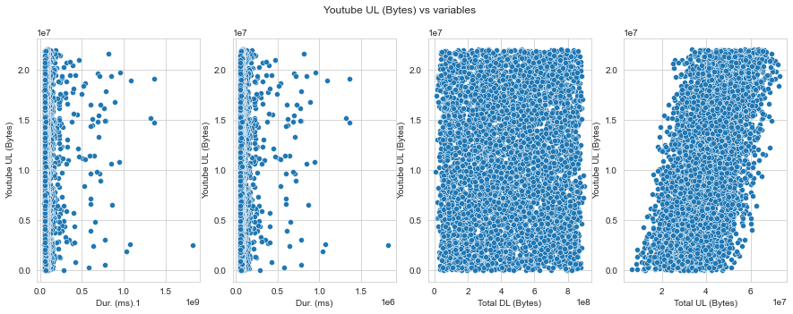
Youtube plots
The duration for both is mostly concentrated between 0-0.5 ms
The total download is equally distributed
The total upload is somewhat distributed with more concentration in the middle

Slide 13
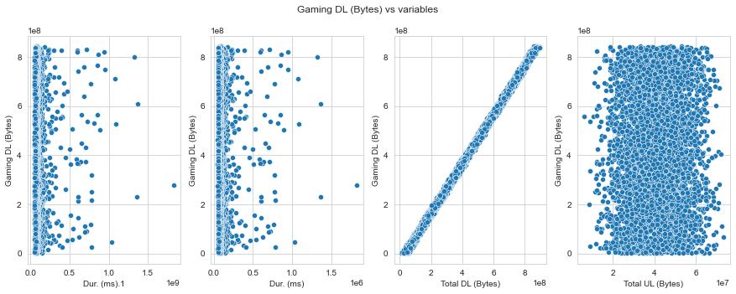
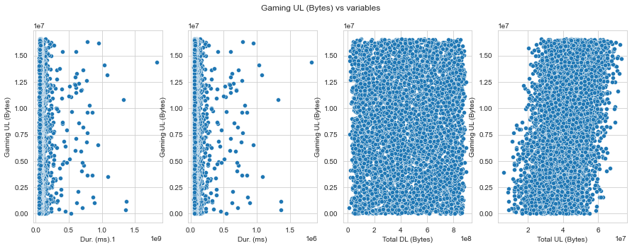
Gaming Plots
The duration for both is mostly concentrated between 0-0.5 ms
The total download is equally distributed on gaming upload but rises in a straight oblique line for gaming download in relation to total download
The total upload is somewhat distributed with more concentration in the middle on total download, and total upload follows an oblique rising pattern in relation to gaming upload

Slide 14
Creator
Names: Floris Nzabakira
Email: nzafloris@gmail.com
GitHub: https://github.com/Kira-Floris/TellCo

